Slide 1

7143CEM Mini-lecture 3-3c: Data Ethics
School of Computing, Electronics and Mathematics Coventry University
7143CEM Programming for Data Science 2020/21 Semester 2

Slide 2
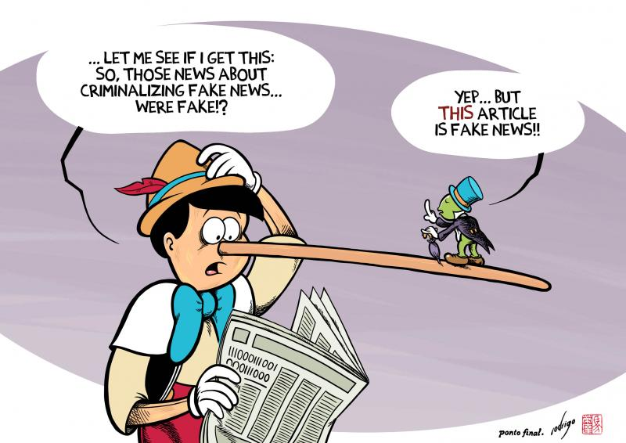
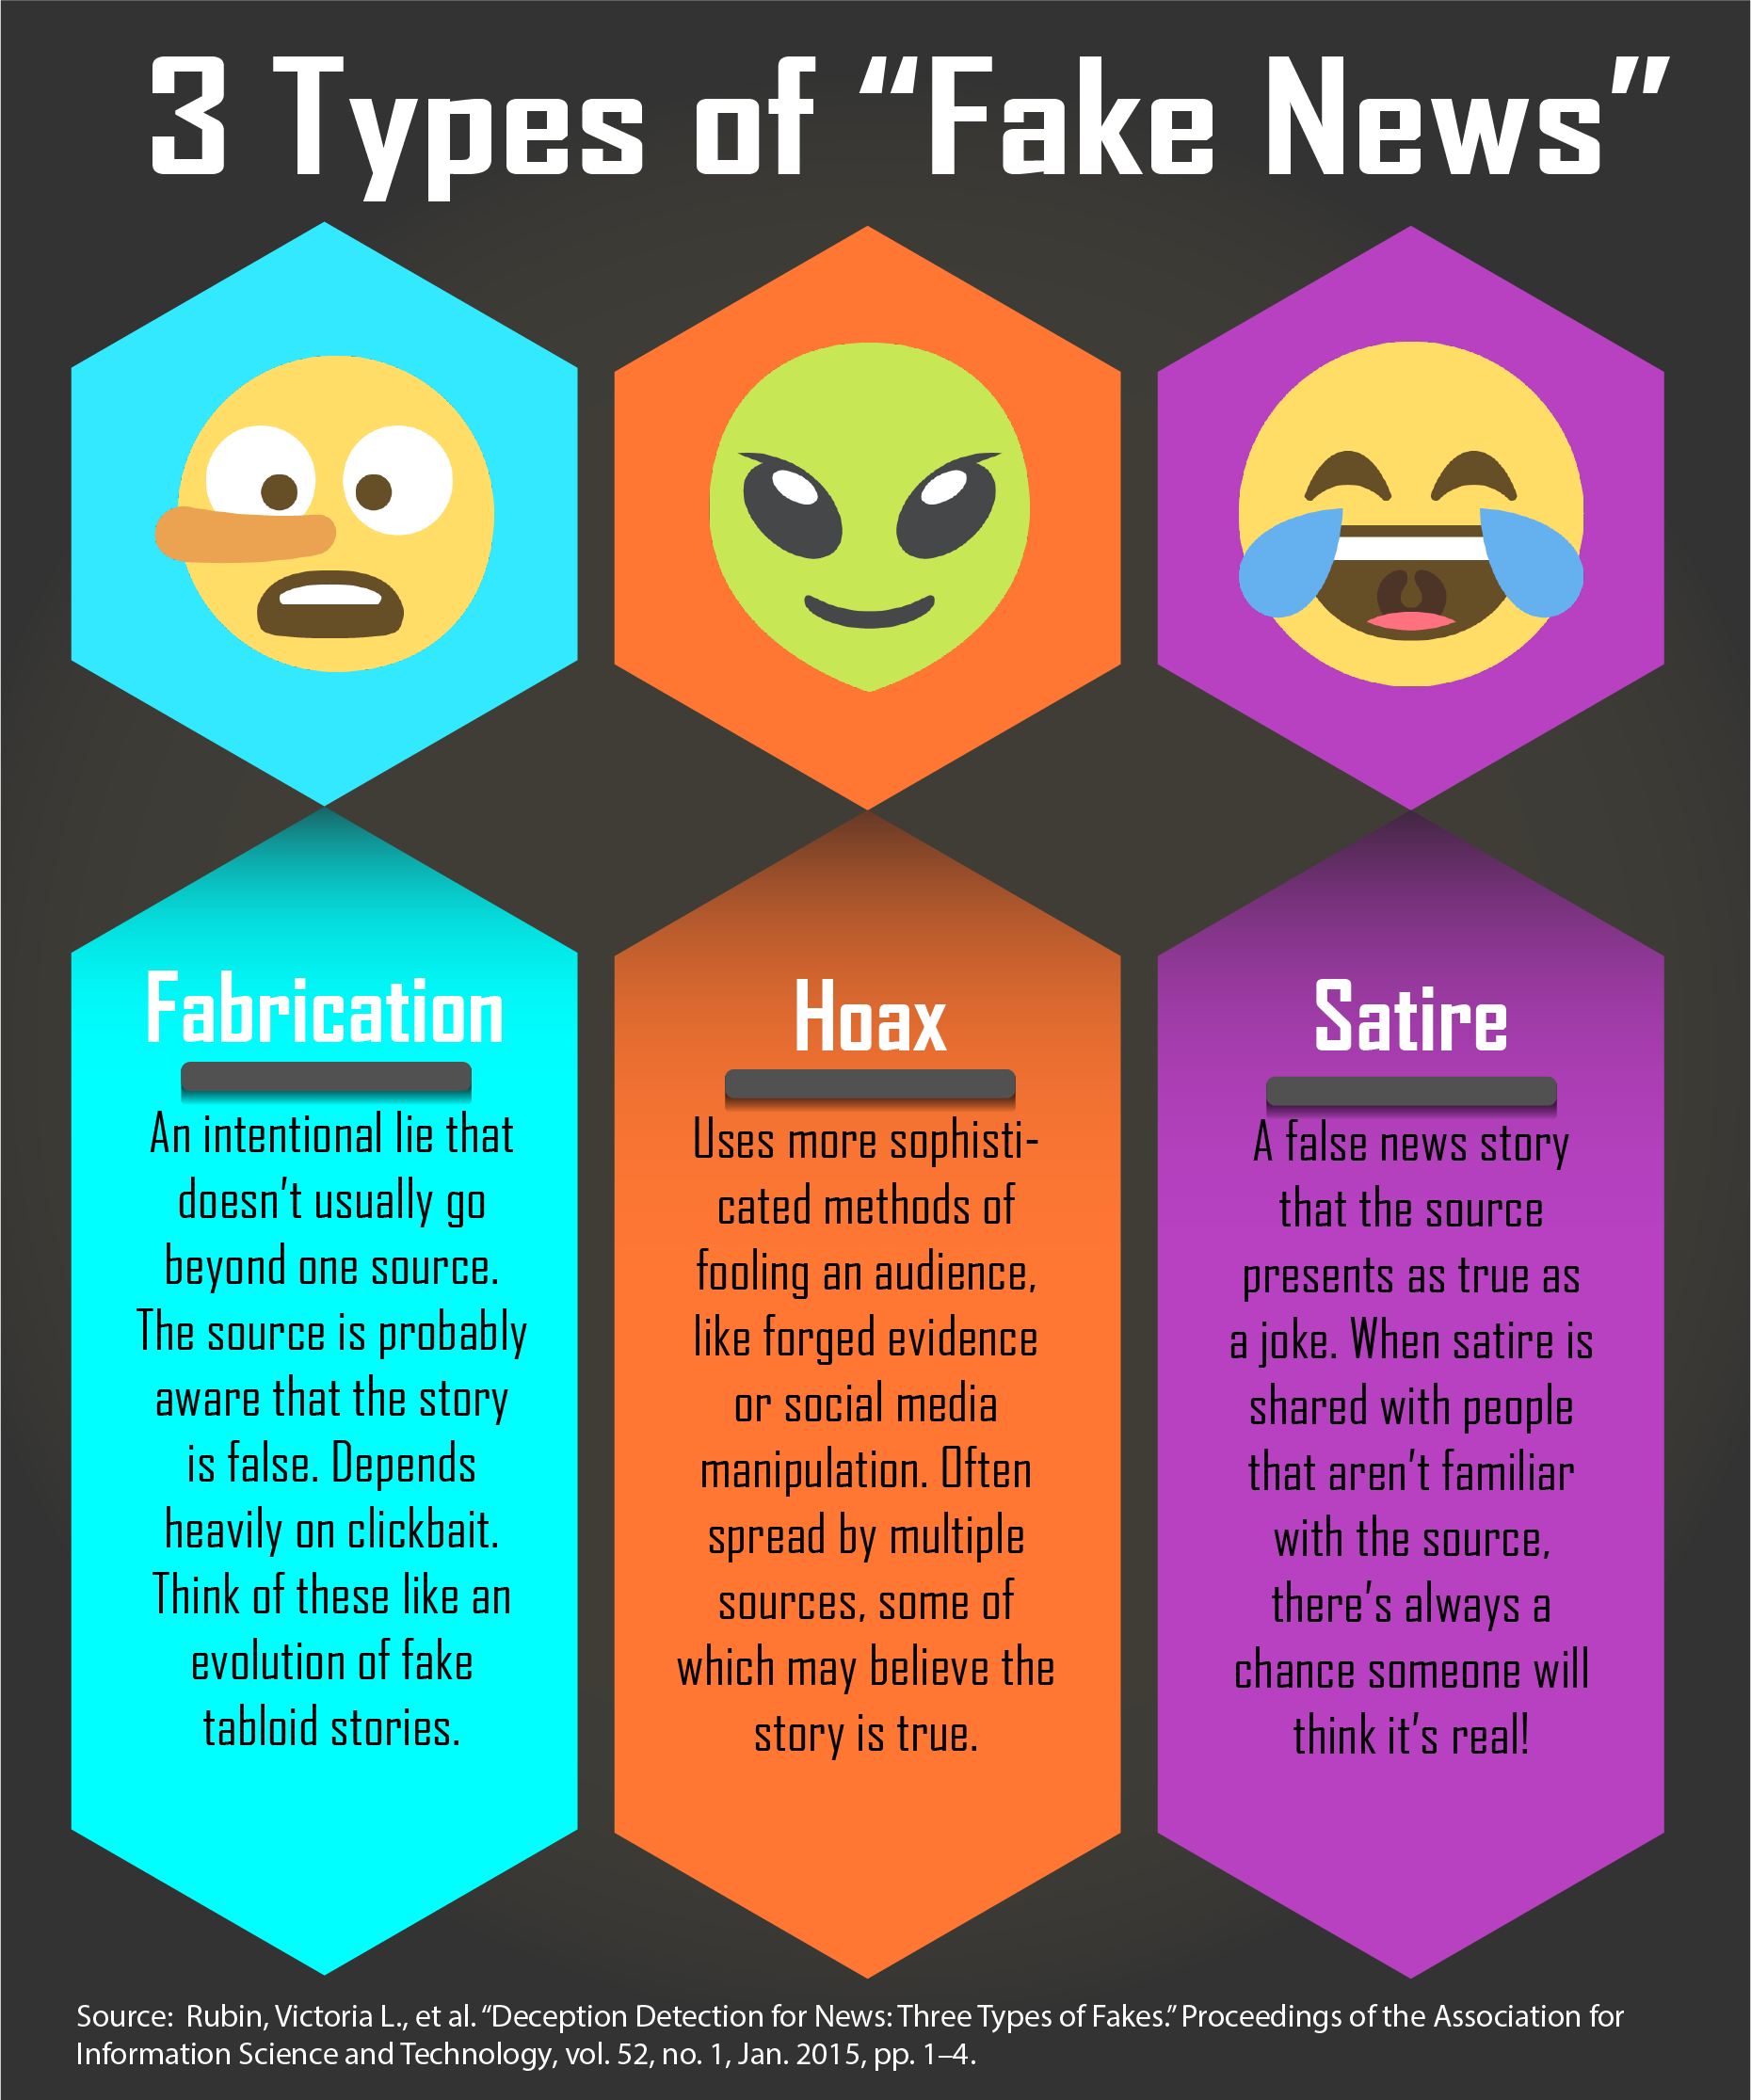
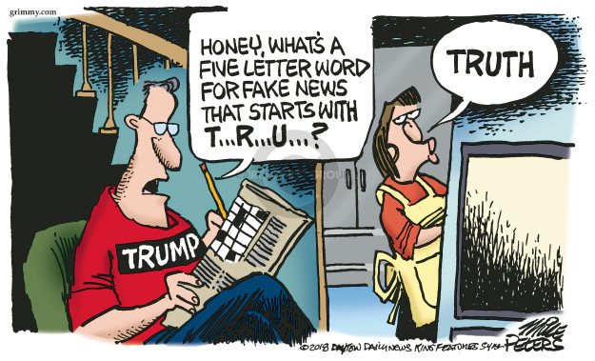
Fake News
Notes:
Image from: https://www.cartoonistgroup.com/subject/The-Fake+news-Comics-and-Cartoons-by-Mike+Peters%27+Editorial+Cartoons.php
Image from: https://cartoonmovement.com/cartoon/faking-fake-news
Image from: https://guides.zsr.wfu.edu/fakenews

Slide 3
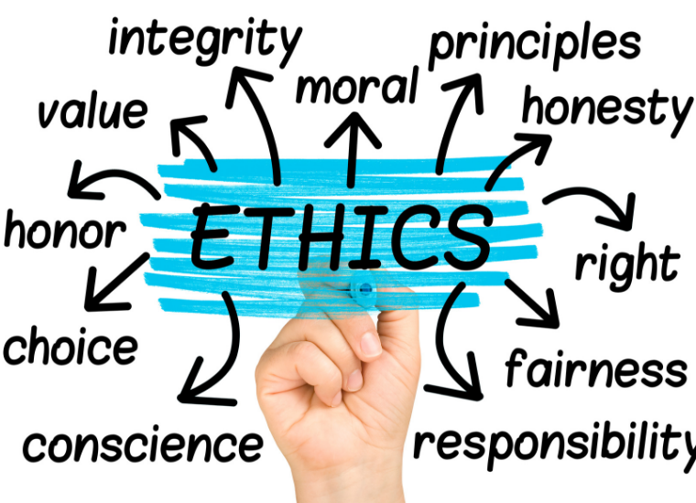
Ethics
“Moral principles that govern a person’s behaviour or the conducting of an activity” (Oxford dictionary)
Examples:
research on humans, animals, genetics
radiation safety
military exports
Beware of unintended consequences
Self-restraint vs pushing the limits
Notes:
Reading: https://www.gov.uk/government/publications/data-ethics-framework/data-ethics-framework-2020
Image: https://www.scu.edu/mobi/resources--tools/blog-posts/ethics-in-life-and-business/ethics-in-life-and-business.html

Slide 4
Data Ethics
What is legal (allowed by law, compliant with regulation)
What is ethical (right, fair, just, risk of negative impact)
Legal
Ethical
Notes:
Reading: https://www.gov.uk/government/publications/data-ethics-framework/data-ethics-framework-2020

Slide 5
Data Ethics
“Computers are useless. They can only give answers”
— Pablo Picasso (1968)
“Ethics really isn’t about agreeing to a set of principles. It’s about changing the way you act.”
— Mike Loukides (2018)
Data ethics is “the set of principles and processes that guide the ethical collection, processing, analysis, use and application of data having an effect on human lives and society”
— Mathieu d’Aquin (2018)
Notes:
Reading: https://www.theguardian.com/commentisfree/2018/apr/25/tech-no-moral-code-racist-ads-cambridge-analytica-technology-ethical-deficit
Reading: https://theodi.org/article/why-should-we-care-about-data-ethics/

Slide 6
Data Ethics
Technology has no ethics. People demonstrate ethics.
Technology inherits the biases of its makers.
GDPR doesn’t address ethics.
Ethics of data — how we generate, record and share data
Ethics of algorithms — how we interpret data via artificial intelligence, machine learning and robots
Algorithmic Justice League https://www.ajl.org/
Ethics of practices — devising responsible innovation and professional codes to guide this emerging science
Notes:
Reading: Floridi, L. and Taddeo, M. (2016). What is data ethics? Philosophical Transactions of the Royal Society A: Mathematical, Physical and Engineering Science, 374, https://royalsocietypublishing.org/doi/10.1098/rsta.2016.0360

Slide 7
Data Ethics
Data is not neutral (data is biased).
There is no such thing as raw data (auditable history).
The signal to noise ratio has changed.
Data is not inherently smart.
The more data we have, the less anonymity.
UK Data Ethics Framework
transparency, accountability, fairness
Notes:
Reading: https://www.theguardian.com/technology/2020/mar/21/catherine-dignazio-data-is-never-a-raw-truthful-input-and-it-is-never-neutral
Reading: https://www.gov.uk/government/publications/data-ethics-framework

Slide 8
Data Ethics
Identity — is offline existence identical to online existence?
“Having two identities for yourself is an example of a lack of integrity.” — Mark Zuckerberg
Privacy — who should control access to data about you?
“Data can be either useful or perfectly anonymous but never both.” — Paul Ohm
Ownership — what does it mean to own data about ourselves?
Reputation — how can we determine what is trust-worthy?
Notes:
Reading: https://www.gov.uk/government/publications/data-ethics-framework/data-ethics-framework-2020

Slide 9
Data Ethics
Transparency — if your data handling actions were known today, would they align with your values?
Data security, privacy and governance.
Uneven access
Self-governance
Consider the data science lifecycle/pipeline
Respect people behind the data
Account for the downstream uses of datasets
Notes:
Reading: https://www.gov.uk/government/publications/data-ethics-framework/data-ethics-framework-2020

Slide 10
Data Anonymisation
Anonymisation is a valuable tool that allows data to be shared, while preserving privacy.
Data/character masking, e.g., credit card number
Pseudonymisation, e.g., fake names
Generalisation, e.g., less precision
Data swapping (permutation)
Data perturbation
Combining anonymised datasets can lead to re-identifying individuals in these datasets (known as the mosaic effect).
Notes:
Reading: https://www.imperva.com/learn/data-security/anonymization/
Reading: https://richmurnane.blogspot.com/2011/01/mosaic-effect.html

Slide 11
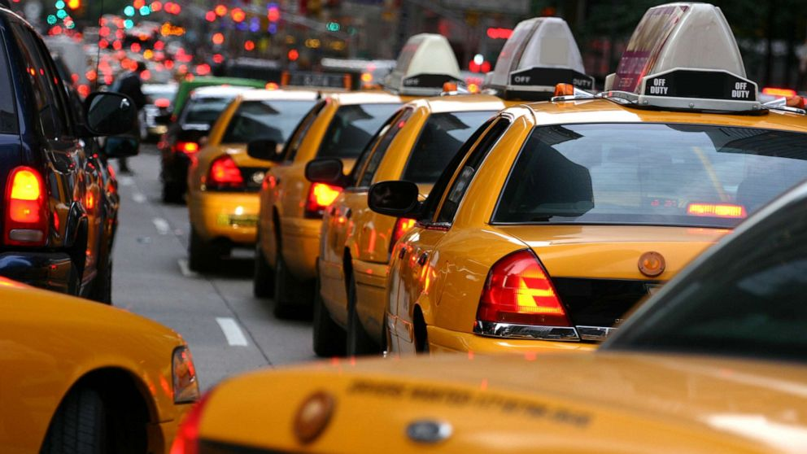
Example: Data Ethics
New York City taxicab database (2013)
https://gawker.com/the-public-nyc-taxicab-database-that-accidentally-track-1646724546
Taxi identifiers later un-anonymised (poorly encrypted) and cross-referenced with time-stamped photos of celebrities entering taxis.
Notes:
Image: https://abcnews.go.com/Business/struggling-nyc-cabs-add-surge-pricing-compete-uber/story?id=68666049

Slide 12
Bias
Bias is when the available data is not representative of the population or phenomenon of study.
Most (almost all) big datasets are biased.
Bias in data produces biased models which can be discriminatory and harmful to humans.
Ensure there is a thorough evaluation of the available data and its processing to mitigate biases.
Notes:
Reading: https://towardsdatascience.com/survey-d4f168791e57

Slide 13
Bias
Garbage in, garbage out (spurious correlation)
Algorithmic reinforcement of human biases
Cognitive bias (anchoring, availability, bandwagon, blind-spot, confirmation, ostrich, placebo, recency, etc)
Under-representation of parts of the population in data
Example: race bias in facial recognition
Example: Microsoft's twitter bot "Tay“
Example: Amazon applicant selection bias against women
Notes:
Reading: https://towardsdatascience.com/bias-what-it-means-in-the-big-data-world-6e64893e92a1
Reading: https://www.tylervigen.com/spurious-correlations

Slide 14
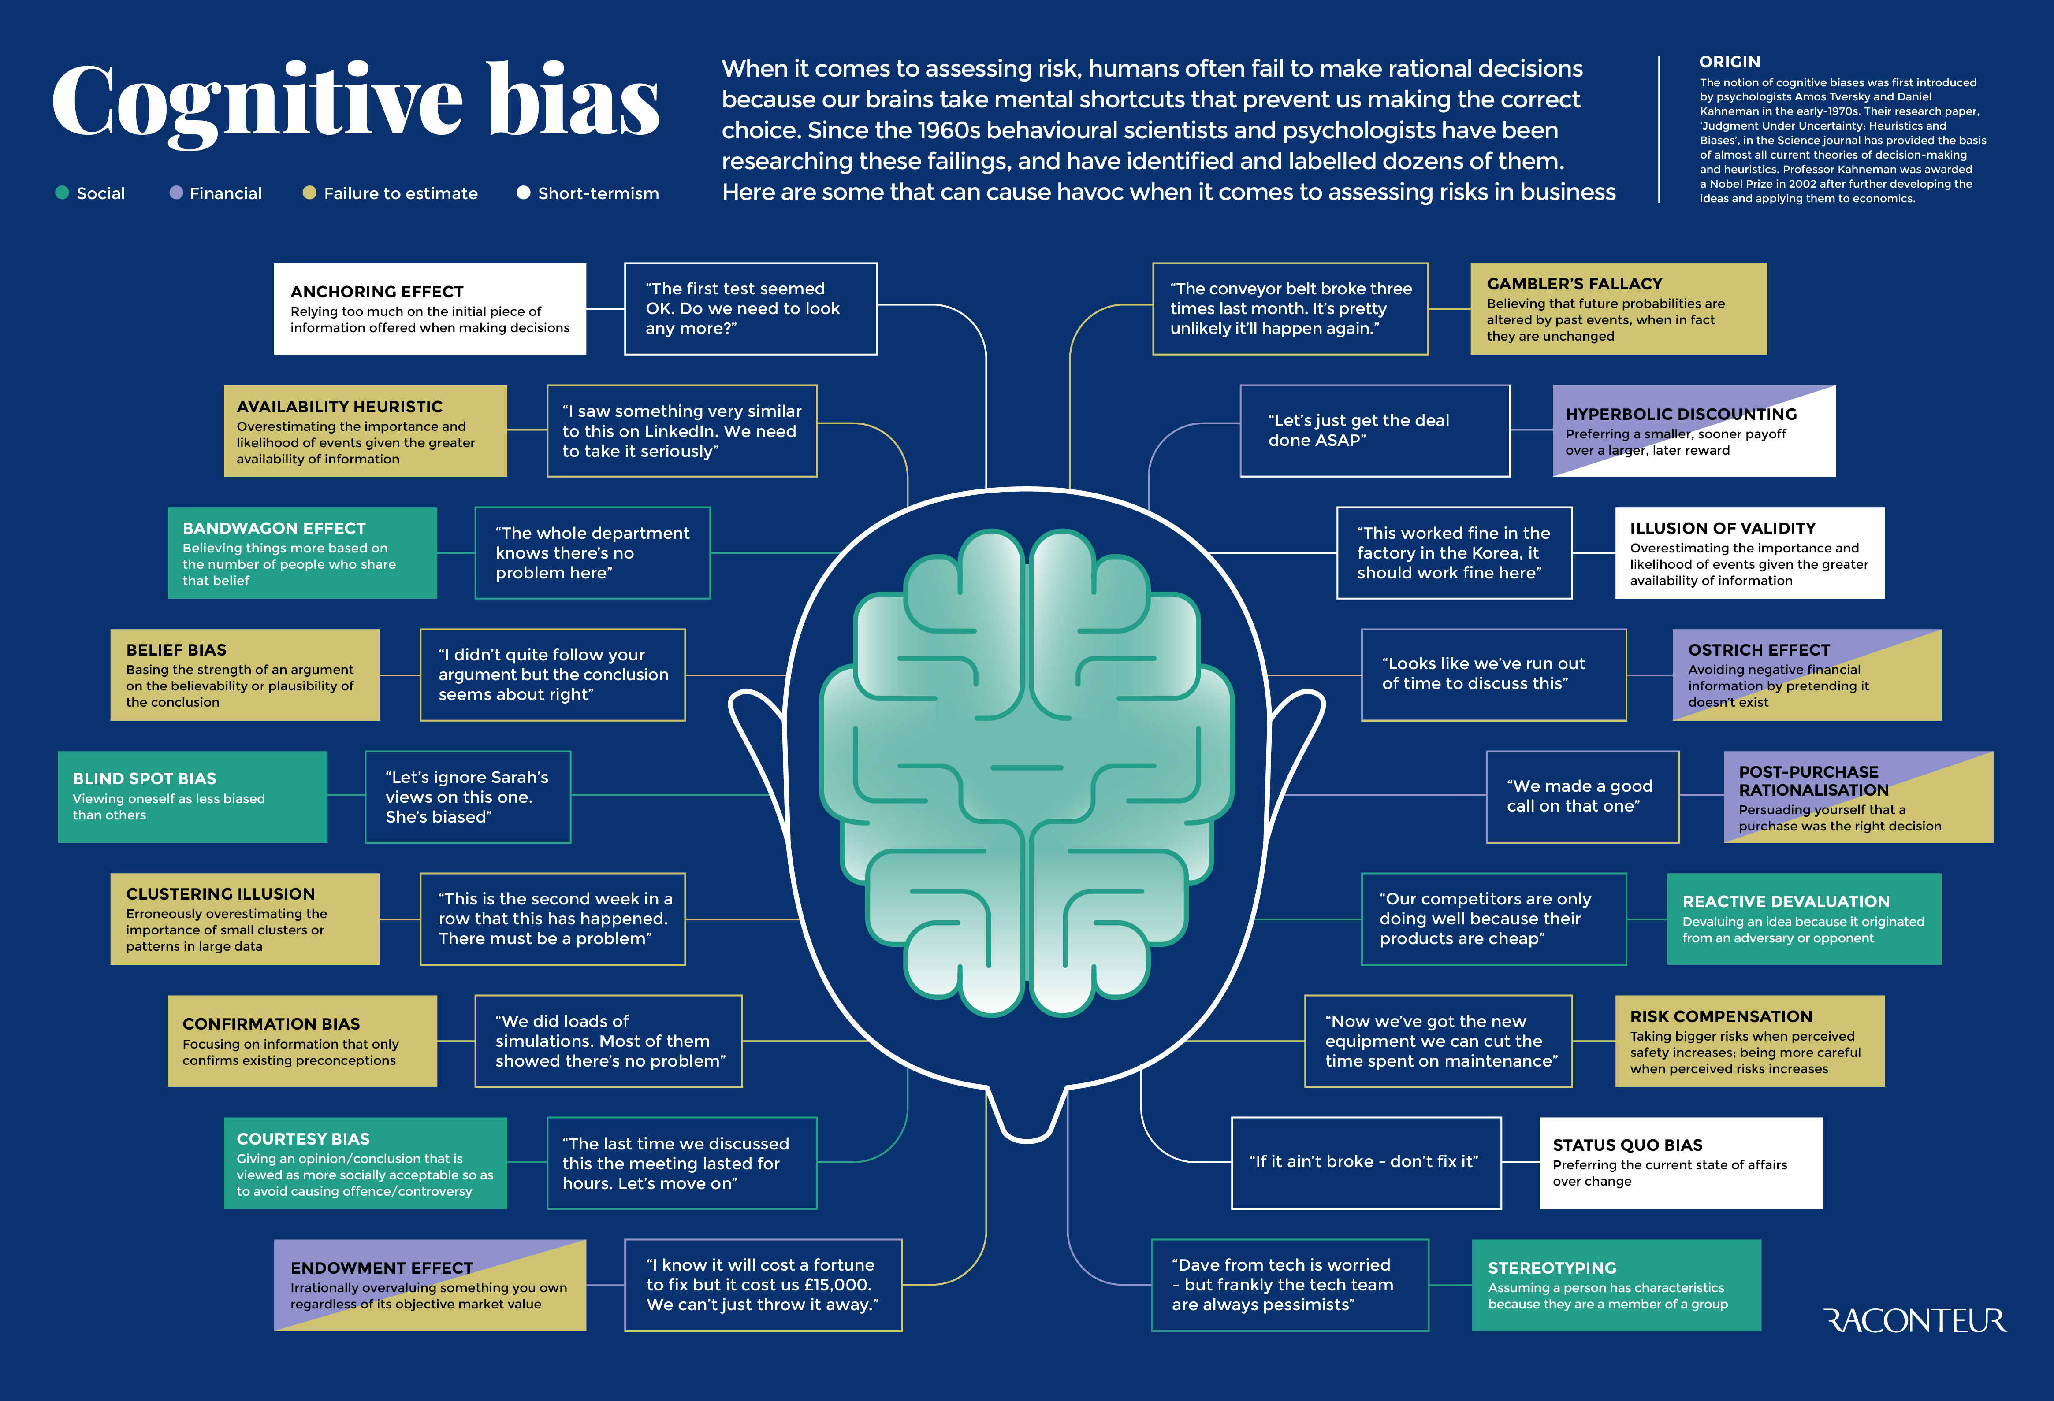
Notes:
Image: https://www.raconteur.net/infographics/cognitive-bias/
Reading: https://cmotions.nl/en/5-typen-bias-data-analytics/

Slide 15
Bias in Data Science
Confirmation bias
Selection bias
Availability bias
Recall/recency bias
Survivourship bias
Outliers
Overfitting and underfitting
Confounding variables
“The average is NOBODY”
Notes:
Reading: https://cmotions.nl/en/5-typen-bias-data-analytics/
Reading: https://www.analyticsinsight.net/top-5-biases-data-science/
Reading: https://www.datasciencecentral.com/profiles/blogs/23-types-of-bias-in-data-for-machinelearning-and-deeplearning

Slide 16
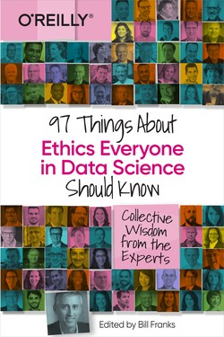
Ethics in Data Science
Ethics is not a binary concept
Unbiased does not equal fair
First, do no harm
Algorithms are used differently than human decision makers
Micro-targeting

Slide 17
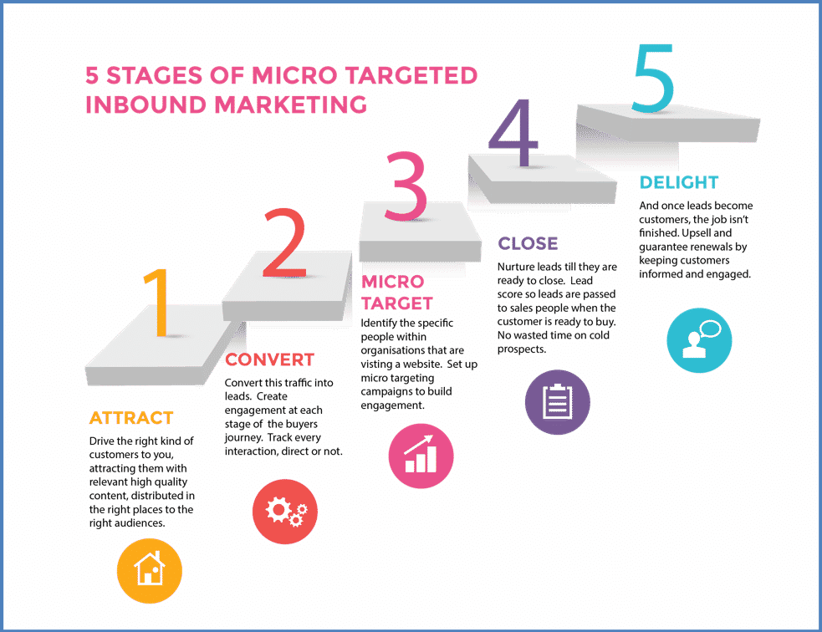
Micro-targeting
Targeted advertising that analyses personal data (behavioural, geographic, psychographic, and demographic) to identify the interests of a specific audience or individual in order to influence their actions or opinions.
Examples: advertising products, political messages
Notes:
Source: https://ico.org.uk/your-data-matters/be-data-aware/social-media-privacy-settings/microtargeting/
Reading: https://www.cleverism.com/what-is-microtargeting/

Slide 18
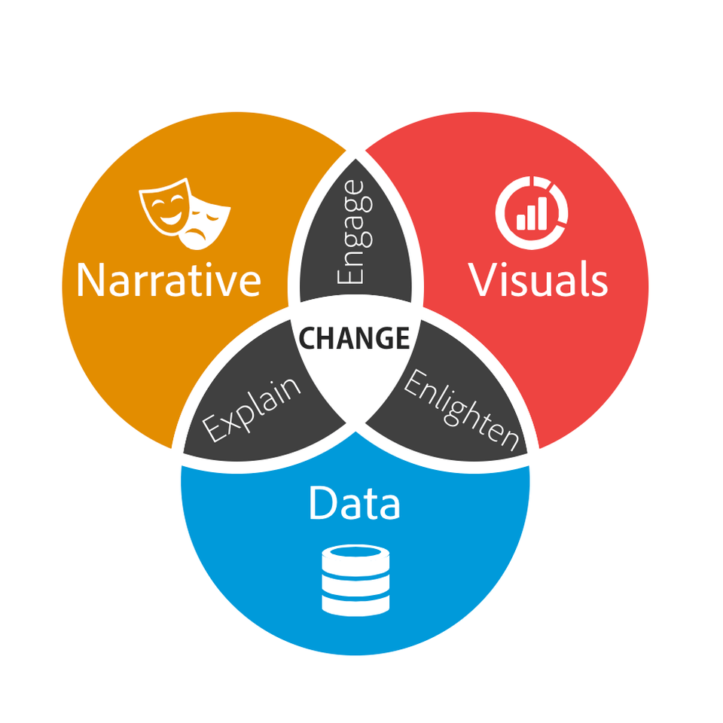
Data Storytelling
“The human mind is a story processor, not a logic processor.” --- Jonathan Haidt
Check your data is accurate and can be trusted
Check for biases and faulty reasoning
Start with data, not with narrative
“Verifying a hypothesis or a hunch with data is different that cherry-picking facts to justify a decision or support an agenda.”
Notes:
Article and Image: https://www.blastanalytics.com/blog/why-data-storytelling-essential-data-science-skill
Quote: https://blogs.scientificamerican.com/guest-blog/it-is-in-our-nature-to-need-stories/

Slide 19
Data Storytelling (negatives)
Limit yourself to a narrower dataset.
Massage the numbers so they align with your message.
Leave out context that could have clarified the data.
Misconstrue what the numbers actually mean.
Visualise the data in misleading ways.
Exclude or discredit conflicting data that undermines your narrative.
Overlook key discrepancies in the supporting data.
Rely on acceptable data from potentially questionable sources.
Notes:
97 Things, p109/p39

Slide 20
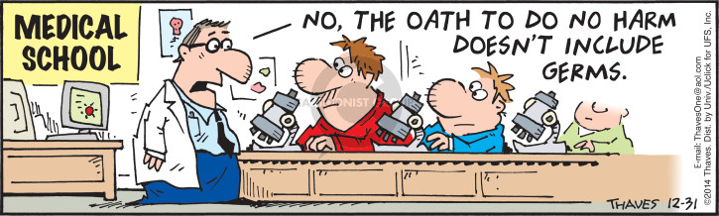
“First, do no harm”
Hippocratic oath (medical professionals)
Responsibility and neutrality
Transparency and honesty
Equity (no illegal or illegitimate discrimination)
Notes:
Reading: https://towardsdatascience.com/hippocratic-oath-for-data-scientists-407d2db15a78
Reading: https://www.theguardian.com/science/2019/aug/16/mathematicians-need-doctor-style-hippocratic-oath-says-academic-hannah-fry
Image: https://www.thecomicstrips.com/subject/The-Hippocratic+Oath-Comic-Strips.php

Slide 21
Data Ethics Scenarios
People looking up financial or contact information of prospective love interests.
Credit card companies and retailers comparing data to determine how many of their customers are also shopping at a competitor.
People reviewing social media to judge a person and make professional and personal decisions.
Notes:
97 Things … p137

Slide 22
Data Ethics Scenarios
Identification of suspects by tracing transaction history at retailers and car rental agencies, camera footage at ATMs, DNA left at crime scenes, etc. Plot of many TV shows.
Comparing a person’s medical prescriptions with their supermarket purchases, e.g., a diabetic who buys a lot of sugary products, or a pregnant woman buying cigarettes.
Creation of fake accounts or social media profiles using readily available information and images to secure loans, slander a person or play a prank.
Notes:
97 Things … p137

Slide 23
Codes of Conduct and Good Practice
British Computer Society (BCS) code: https://www.bcs.org/membership/become-a-member/bcs-code-of-conduct/
Royal Statistical Society (RSS) code: https://rss.org.uk/about/policy-and-guidelines/code-of-conduct/
Oxford-Munich code: http://www.code-of-ethics.org/

Slide 24
Summary
What is legal might not be ethical.
Ethics of data, algorithms and practices.
Consider downstream uses of data and potential unintended consequences.
Anonymisation and the mosaic effect.
Bias (garbage in, garbage out).
Data storytelling and the Hippocratic oath.
Codes of conduct and good practice.

